Slide 1

BUSINESS IMPLEMENTATION
Raija westerlund

Slide 2

Entrepreneurship
The entrepreneur is a person who, alone or together with others, carries out activities in a business whose objective is to make a profit. These activities include a degree of risk taking.
Entrepreneuer: Idea, skills
Business mission
Risk, a possibility of failure and financial risk
Profitable, sales revenue must be sufficient to cover all business expenses

Slide 3
The right way to start a business
Three main drivers that lead one to start a business:
IDEA/PRODUCT/TECH
NEED
PASSION
Which one is more likely to succeed?

Slide 4
If you’re dealing with a starting enterprise, clarify also the following issues:
Where did the business idea come from?
What are the goals or motivation for becoming an entrepreneur?
What challenges does the entrepreneurial activity bring to the founder?
What know-how qualities does the business require? What strengths/weaknesses do you/your partner have in these qualities?

Slide 5
The Business Idea
It has to provide something that consumers are willing to buy!
A business idea originating from one’s own know-how
education or work experience
product could be further developed or new uses for it could be found
It could be made more cost-effectively
new channels of distribution
Idea can be based on know-how gained throught hobbies etc.

Slide 6
2. Imitation Strategy
borrowed idea from another company
3. Systematic Search for Business Idea
making a systematic investigation of the market (niches in the market, consumers needs and buying habits, how social values, legislation and technical/commercial regulations change)
4. Product Development
5. Purchasing a ready-made product idea or buying out a company

Slide 7
Purpose of a corporation
To provide customer or end users what they need, want, & will pay.
To do it profit/sustain-ably over a long period of time.
Provide stakeholders with expected return.
Generating well-being and positive change for individuals, communities, and entire societies.

Slide 8
The Business Process
Raw-materials
Premises
Energy
Machinery
Labour force
Know-how
Products
Goods
Services
Company
Purchasing costs
Profitability
Sales income
Cash expenditure
Liquidity
Cash income
Solvency
Shareholders’ capital
Liabilities

Slide 9
Interest Groups
Company
Management
Employees
Customers
Competitors
Financiers
Owners
Suppliers
Public authorities

Slide 10
Difference between stakeholders and shareholders
Have an interest in the business -but do not own it
May work for (employees) or otherwise transact with the business
Own the business
May also work in the business
Benefit directly from increases in the value of the business

Slide 11
Company
Inputs
Interest Group
Compensations

Slide 12
Stakeholders | Mainly intrested in…
Shareholders / Owners | Return on investment + profit and dividends Success and growth of the business Proper running of the business
Manager & Employees | Rewards, including basic pay and other financial incentives Job security &working conditions Promotion opportunities + job satisfaction & status-motivation, roles and responsibilities
Customers | Value for money Product quality & customer service

Slide 13
Stakeholders | Mainly intrested in…
Supplies | Continued, profitable trade with business Financial stability-can the business pay its bills?
Banks & other finance providers | Can the business repay amounts loaned or invested? Profitability and cash flows of the business Growth in profits and value of the business
Government | The correct collection and payment of taxes (VAT) Helping the business to grow – creating jobs Compliance with business legislation
Society | Success of the business – particularly creating and retaining jobs Compliance with local laws and regulations (e.g. noise, pollution)

Slide 14
Entrepreneurship is an essential part of society and therefore the representatives of society have established a set of rules for companies and their representatives. Through legislation and other control measures, public authorities (state, municipalities, parishes) act as an interest group and define the rights and responsibilities of the company and its interest groups.
These regulations and agreements are different in different countries and cultures, even though the main principles are similar. In Finland legislation between a company and interest groups includes for example:
Suppliers: Commercial Code, Legal Transactions Act
Customers: consumer protection legislation
Competitors: competition legislation
Management: employment legislation
Owners: company legislation
Financiers: promissory notes legislation
Public authorities: tax legislation, accounting legislation.
In addition to above, a company can supplement its relations with interest groups through mutual agreements.

Slide 15
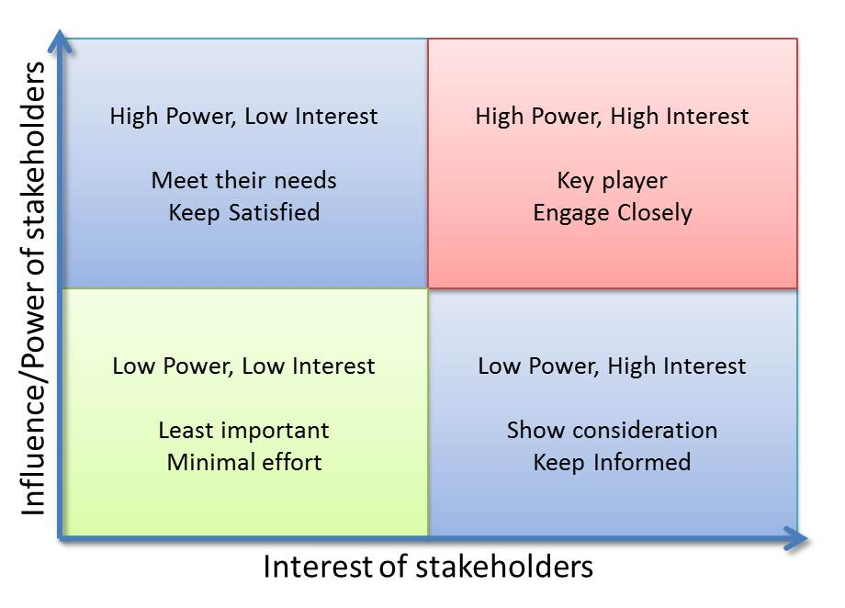
Stakeholder Map

Slide 16
The Single Necessary Condition
he single necessary condition for a new venture success – & two words that define the course:
PAYING CUSTOMER

